Slide 1
IPL ANALYSIS - RCB IPL STRATEGY
B VIGNESH 24-08-2024

Slide 2
ABOUT IPL
ABOUT RCB
The IPL is a premier Twenty20 cricket league in India, renowned for its high-energy matches, city-based teams, and global player auction, which has popularized shorter formats of cricket and influenced leagues around the world.
It significantly drives the economy through sponsorships, broadcasting rights, and tourism, generating substantial financial benefits.
The Royal Challengers Bangalore (RCB), established in 2008 and based in Bangalore, is known for its star players like Virat Kohli and AB de Villiers, and plays its home matches at M. Chinnaswamy Stadium.
Despite not winning an IPL title yet, RCB is renowned for high-scoring matches and record-breaking performances, making it one of the most popular and commercially successful teams in the league.

Slide 3
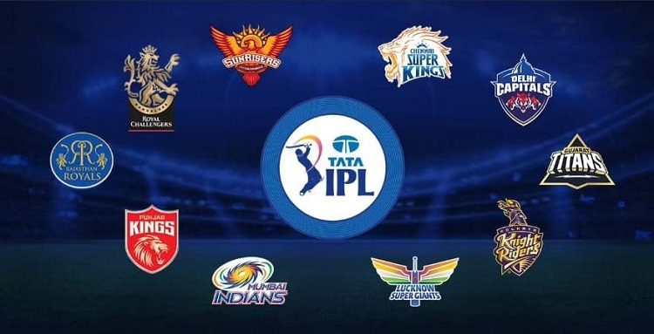
DATA OVERVIEW
TOTAL NUMBER OF MATCH PLAYED DATA : 577
TOTAL NUMBER OF PLAYER’S DATA : 469
TOTAL NUMBER OF TEAMS DATA : 13
The IPL SQL database holds extensive data on various aspects of the Indian Premier League, including player details such as IDs, names, birth dates, batting hands, and bowling skills.
It tracks match specifics, including match IDs, dates, participating teams, and match outcomes.
The database records detailed ball-by-ball information, including runs scored, wickets taken, and types of dismissals, as well as extra runs and their types.
It stores information on seasons, such as Man of the Series and cap winners, along with data on cities and countries.
The organized structure of the database facilitates detailed analysis and querying of IPL data.

Slide 4

PROBLEM STATEMENT
You are hired as a sport data analyst by RCB where the team is looking for top-performing and reliable players to win tournaments, considering both on-field performance and value for money in mega player auction of 2017.
Your task is to come up with strategies/suggestions regarding selecting the best-performing players and optimizing player auction investments.

Slide 5
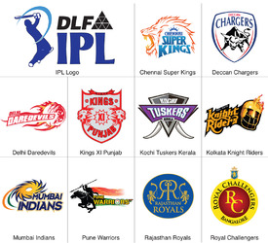
IPL TEAMS OVERVIEW
IPL CHAMPIONS
TEAM PLAYING
YEAR
WINNER
2008
Rajasthan Royals
2009
Deccan Chargers
2010
Chennai Super Kings
2011
Chennai Super Kings
2012
Kolkata Knight Riders
2013
Mumbai Indians
2014
Kolkata Knight Riders
2015
Mumbai Indians
2016
Sunrises Hyderabad
2015

Slide 6


TOP 10 RUN SCORERS AND WICKET TAKERS IN IPL

Slide 7
CONSISTENT BATSMENS – BOWLERS IN IPL
CONSISTENT BATSMENS – BOWLERS IN IPL
The most consistent batsmen in IPL history scored over 700 runs in a seasons.
The most consistent bowlers in IPL history took at least 15 wickets in a seasons.

Slide 8
CONSISTENT ALL ROUNDERS IN IPL
These players have scored over 1000 runs and taken more than 30 wickets. They excel in both batting and bowling.
consistence All rounder’s in overall seasons of the IPL.They scored more then 400 runs and took 8 wickets in 4 out of 9 seasons.
PLAYERS | BATTING SESSONS | BOWLING SESSONS
JH Kallis | 6 | 4
KA Pollard | 6 | 4
SR Watson | 6 | 5

Slide 9

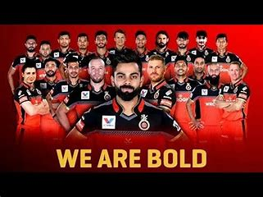
RCB RECORDS ACROSS ALL VENUE
Venue | Matches | Won | Loss | Win Percentage
M Chinnaswamy Stadium | 54 | 29 | 25 | 53.7
Feroz Shah Kotla | 6 | 4 | 2 | 66.67
Wankhede Stadium | 7 | 3 | 4 | 42.86
Eden Gardens | 7 | 3 | 4 | 42.86
Sawai Mansingh Stadium | 5 | 3 | 2 | 60
Kingsmead | 4 | 3 | 1 | 75
New Wanderers Stadium | 4 | 3 | 1 | 75
Rajiv Gandhi International Stadium, Uppal | 7 | 2 | 5 | 28.57
Punjab Cricket Association Stadium, Mohali | 5 | 2 | 3 | 40
MA Chidambaram Stadium, Chepauk | 8 | 2 | 6 | 25
SuperSport Park | 3 | 2 | 1 | 66.67
Subrata Roy Sahara Stadium | 2 | 2 | 0 | 100
Maharashtra Cricket Association Stadium | 2 | 2 | 0 | 100
Newlands | 2 | 1 | 1 | 50
Brabourne Stadium | 1 | 1 | 0 | 100
Dr DY Patil Sports Academy | 2 | 1 | 1 | 50
Nehru Stadium | 1 | 1 | 0 | 100
JSCA International Stadium Complex | 3 | 1 | 2 | 33.33
Sharjah Cricket Stadium | 2 | 1 | 1 | 50
Dubai International Cricket Stadium | 2 | 1 | 1 | 50
Sardar Patel Stadium, Motera | 1 | 1 | 0 | 100
Punjab Cricket Association IS Bindra Stadium, Mohali | 1 | 1 | 0 | 100
Shaheed Veer Narayan Singh International Stadium | 1 | 1 | 0 | 100
St George's Park | 3 | 0 | 3 | 0
Vidarbha Cricket Association Stadium, Jamtha | 1 | 0 | 1 | 0
Himachal Pradesh Cricket Association Stadium | 1 | 0 | 1 | 0
Sheikh Zayed Stadium | 1 | 0 | 1 | 0
Saurashtra Cricket Association Stadium | 1 | 0 | 1 | 0

Slide 10

RCB STATISTICS
RCB PREVIOUS SESSON RECORDS
IPL Sesson Year | Matches | Won | Loss | Win Percentage
2008 | 14 | 4 | 10 | 28.57
2009 | 16 | 9 | 7 | 56.25
2010 | 16 | 8 | 8 | 50
2011 | 16 | 10 | 6 | 62.5
2012 | 15 | 8 | 7 | 53.33
2013 | 16 | 9 | 7 | 56.25
2014 | 14 | 5 | 9 | 35.71
2015 | 16 | 8 | 6 | 50
2016 | 16 | 9 | 7 | 56.25
RCB ALL MATCHES RECORD
RCB PREVIOUS SESSON RUNS AND WICKETS
Total Matches | Won | Loss | No result | Win Percentage
139 | 70 | 67 | 2 | 50.35
IPL Sesson Year | Runs | Wickets
2008 | 2008 | 85
2009 | 2293 | 92
2010 | 2360 | 85
2011 | 2295 | 75
2012 | 2361 | 84
2013 | 2419 | 84
2014 | 2003 | 78
2015 | 2366 | 92
2016 | 2849 | 93
RCB HOME MATCHES RECORD
Matches | Won | Loss | No result | Win Percentage
56 | 29 | 25 | 2 | 51.78
RCB AWAY MATCHES RECORD
Matches | Won | Loss | No Result | Win Percentage
83 | 41 | 42 | 0 | 49.39

Slide 11

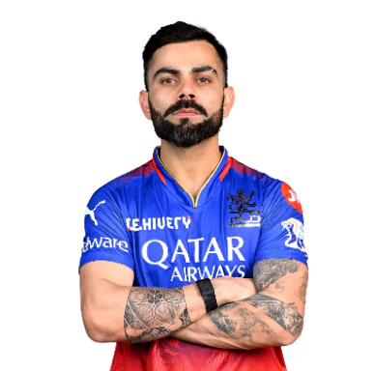

RCB RECORD M Chinnaswamy Stadium(HOME)GROUND
RCB HOME MATCHES RECORD
Matches | Won | Loss | No result | Win Percentage
56 | 29 | 25 | 2 | 51.78
TOP 5 RUNS SCORERS IN RCB HOME
Venue | Batsman | runs | batting_avg
M Chinnaswamy Stadium | V Kohli | 3429 | 64.69
M Chinnaswamy Stadium | CH Gayle | 2481 | 65.28
M Chinnaswamy Stadium | AB de Villiers | 2258 | 55.07
M Chinnaswamy Stadium | JH Kallis | 768 | 48
M Chinnaswamy Stadium | TM Dilshan | 689 | 62.63
TOP 5 WICKET TAKERS IN RCB HOME
Venue | Bowler | wickets | Bowling_Avg
M Chinnaswamy Stadium | R Vinay Kumar | 32 | 20.56
M Chinnaswamy Stadium | YS Chahal | 31 | 18.29
M Chinnaswamy Stadium | Z Khan | 31 | 21.67
M Chinnaswamy Stadium | S Aravind | 22 | 14.18
M Chinnaswamy Stadium | SR Watson | 21 | 15.52

Slide 12

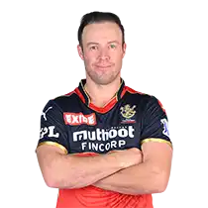
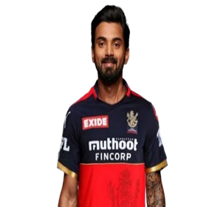
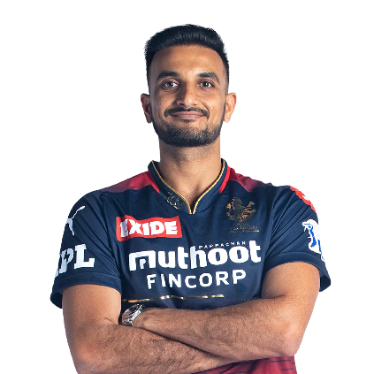
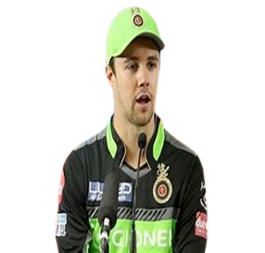
RETAINED PLAYERS AND NEW PLAYERS SELECTION
V Kohli
AB de Villiers
KL Rahul
YS Chahal
HV Patel
TM Head
Retained Players : Above 6 players retained due to good performance and fitness.
Released Players : All others released due to low performance and fitness issues.
New Additions :
Batting: M Vijay (reliable opener), DA Miller (powerful middle-order hitter).
All-Rounders: HH Pandya, RA Jadeja, DJ Bravo, JP Duminy, V Shankar, N Rana (balanced and versatile options).
Spin Bowling: Kuldeep Yadav (wrist spin), R Ashwin (experienced off-spin).
Pace Attack: MA Starc (left-arm pace), PJ Cummins (fast bowling) to strengthen pace options.
These additions aim to make RCB's squad well-rounded and balanced.

Slide 13

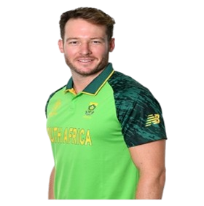
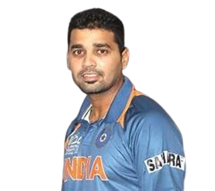

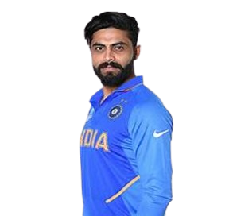
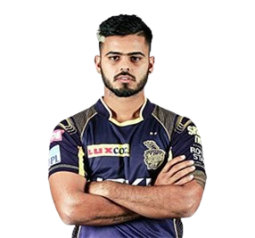
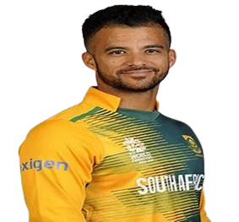
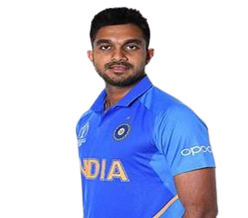
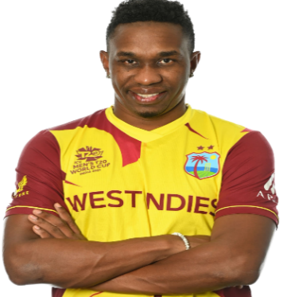
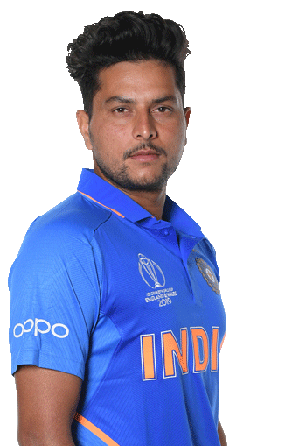
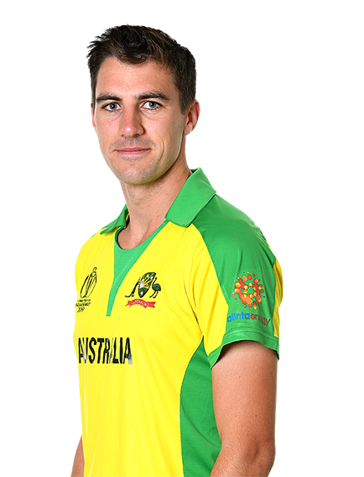
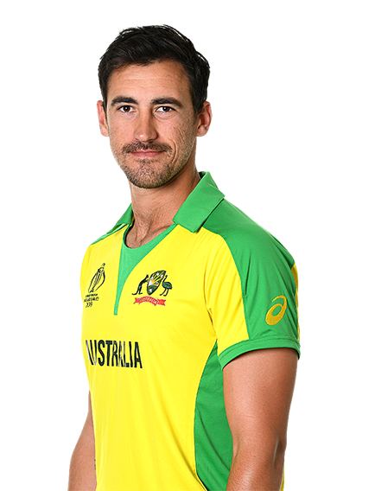

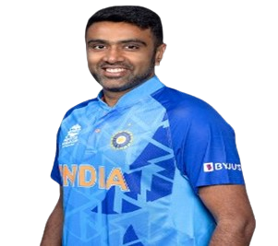
RCB SQUARD FOR IPL 10 – 2017 (AFTER AUCTION)
BATMENS
V Kohli (C)
AB de Villiers
KL Rahul(VC)(WK)
TM Head
DA Miller
M Vijay
ALLROUNDERS
HH Pandya
RA Jadeja
DJ Bravo
N Rana
JP Duminy
V Shankar
BOWLERS
MA Starc
HV Patel
YS Chahal
Kuldeep Yadav
PJ Cummins
R Ashwin

Slide 14

RCB Playing XI and Substitutes
Playing XI
V Kohli (Captain) - Provides stability and leadership.
TM Head - Brings aggression at the top.
AB de Villiers - Key finisher and middle-order strength.
KL Rahul (VC) (WK) - Flexibility in batting, anchors or accelerates as needed.
HH Pandya - Dynamic all-rounder who adds depth to both batting and bowling.
RA Jadeja - All-rounder with versatile skills.
DJ Bravo - Experienced in death-overs and finishing.
Kuldeep Yadav - Effective leg-spinner for middle overs.
MA Starc - Leading fast bowler with death-overs expertise.
YS Chahal - Key spinner for middle-over breakthroughs.
HV Patel - Adds depth to the pace attack.
Substitutes
DA Miller - Backup power hitter.
PJ Cummins - Additional pace option.
R Ashwin - Spin option for varying conditions.
M Vijay - Backup top-order batsman.
V Shankar - All-rounder for added balance.
N Rana - Middle-order backup.
JP Duminy - Versatile all-rounder with batting and bowling options.

Slide 15
CONCLUSION
V. Kohli's strategic leadership provides stability and strong guidance in high-pressure situations.
The squad benefits from aggressive and adaptable batting with AB de Villiers ,TM Head and KL Rahul, balanced by all-rounders HH Pandya,RA Jadeja and DJ Bravo who strengthen both batting and bowling.
The diverse bowling attack, featuring MA Starc, YS Chahal, and Kuldeep Yadav, along with experienced finishers and versatile substitutes like DA Miller, and PJ Cummins, ensures adaptability and resilience throughout the season.

